Slide 1
DATA CLEANSING
To get started, I installed the following packages into the R script to work with.
Janitor: A package for data cleaning and data frame tidying.
Naniar: A package that works with missing values in R.
Dplyr: A package for data manipulation and data wrangling in R.
Ggplot: Enables that plot charts in R
Then we started by working with:
Missing values (NAs)
Managing NAs. Correcting data types.
Manipulating strings
Reorganizing the data.

Slide 2
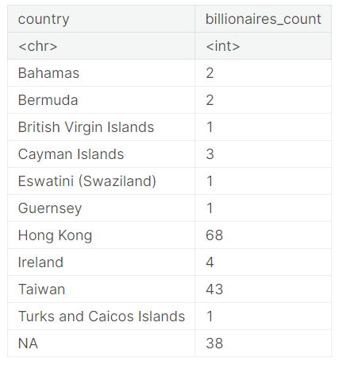
DATA CLEANSING Contd.
Replace missing values in the "Age" column with the mean age: Calculation was done to find the mean age of the age of billionaires excluding the missing values using the code:
mean_age <- mean(b_data$age, na.rm = TRUE)print(mean_age)
Then, replace the missing values with the mean age:
b_data$age[is.na(b_data$age)] <- mean_age
Following actions was also made to standardize the dataset:
Remove Commas and Dollar Signs in the "gdp_country" country and convert to numeric type
Summarizing the count of billionaires in each country with missing GDP data:
The figure shows the count and grouped of billionaires by country of origin with 38 billionaires whose origins are missing.

Slide 3
DATA CLEANSING Contd.
We ignore these billionaires without origin and fill in the missing values with an external GDP file that accompanied our dataset.
We fill in the missing values for known countries and will ignore 38 missing values that their countries are unknown.
b_data$gdp_country <- ifelse(is.na(b_data$gdp_country), external_gdp_data$gdp_country[match(b_data$country, external_gdp_data$country)],b_data$gdp_country)

Slide 4
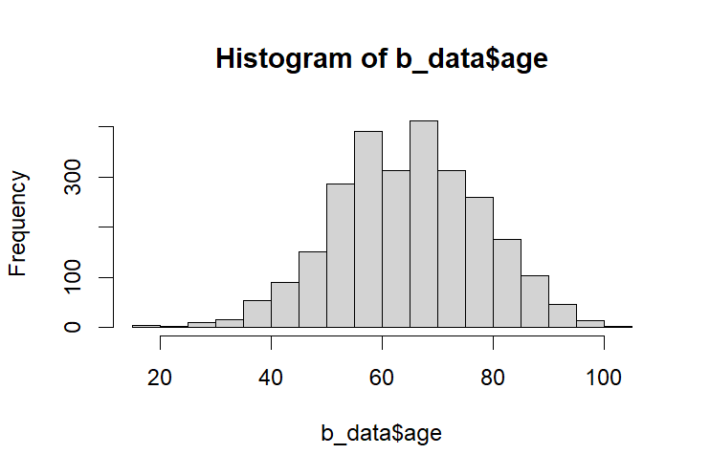
RESEARCH QUESTIONS: 1
What is the distribution of the age of billionaires in 2023? Are there any notable age trends among the world's billionaires?
I approached this question by calculating the measure of central tendencies of our data.
mean(b_data$age)
median(b_data$age)
sd(b_data$age)
IQR(b_data$age) - (InterQuartile Range)
The median age, which is also approximately 65.14 years, is very close to the mean age. This indicates that the age distribution of billionaires is relatively symmetric. Some billionaires are notably younger or older than the average. Most billionaires tend to be in their mid-60s.
Mean: 65.14019
Median: 65.14019
SD: 13.0938
IQR: 18

Slide 5
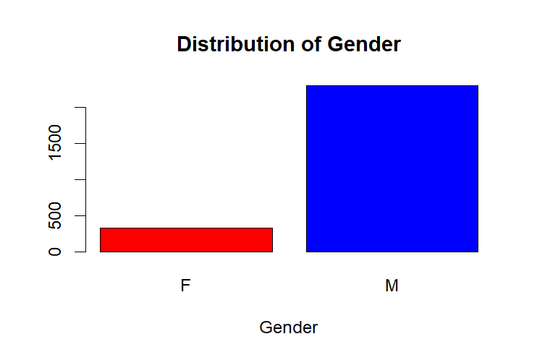
RESEARCH QUESTIONS: 2
What is the distribution of the gender of billionaires in 2023? What is the gender makeup of the billionaire population?
I approached this question by calculating the frequency table of the Gender variable.
billionaire_gender<-b_data$gender gender_frequency<-table(gender) print(gender_frequency)
Billionaires Gender
Female | Male
337 | 2303
Approximately 12.76% of billionaires are female, while around 87.23% are male. This means that the majority of billionaires in 2023 are male, with female makes up a smaller proportion of the billionaire population
% of Gender
Female | 12.76%
337 | 87.23%

Slide 6
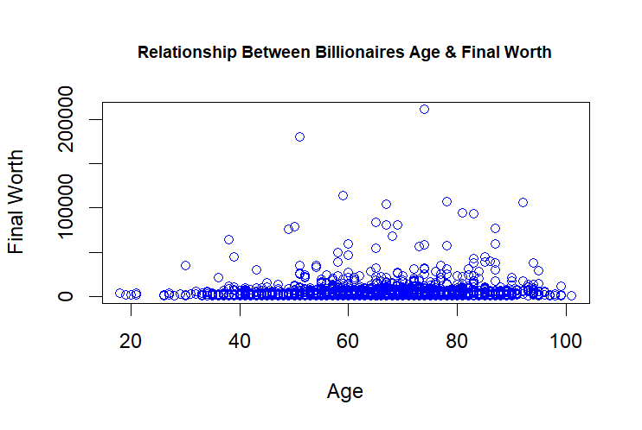
RESEARCH QUESTIONS: 3
Is there a linear relationship between a billionaire's age at the time of data collection and their final net worth? In other words, does age correlate with wealth for billionaires in 2023?
We looked at the relationship between Age and Final Worth using the Scatter plot chart.
Variables: Age (Quantitative) and Final Worth (Quantitative)
plot(b_data$age,b_data$final_worth,
main = "Relationship Between Billionaires Age & Final Worth",
xlab = "Age",
ylab = "Final Worth",
col = "blue",
pch = 1,
cex.main = 0.8)
We run a correlation/regression analysis to ascertain this.
correlation<- cor(b_data$final_worth, b_data$age) print(correlation)
Ans: 0.06695056
A correlation of 0.06695056 indicates a very weak, positive relationship between age and final net worth among billionaires in your dataset, and it does not provide much predictive power or explanatory value for final net worth based on age.

Slide 7
CONCLUSION
The median age, which is also approximately 65.14 years, is very close to the mean age. This indicates that the age distribution of billionaires is relatively symmetric. Some billionaires are notably younger or older than the average. Most billionaires tend to be in their mid-60s.
Approximately 12.76% of billionaires are female, while around 87.23% are male. This means that the majority of billionaires in 2023 are male, with female makes up a smaller proportion of the billionaire population
A correlation of 0.06695056 indicates a very weak, positive relationship between age and final net worth among billionaires in your dataset, and it does not provide much predictive power or explanatory value for final net worth based on age.

